Slide 1
Project 3 Interim Presentation: Trajectories of Onset of Memory/Cognitive Loss
Rachel Johnson

Slide 2
Data Summary
 |  | Overall | Did not develop dementia/MCI during study | Developed dementia/MCI during study
n |  | 216 | 145 | 71
Gender (n (%)) | Male | 91 (42.1) | 67 (46.2) | 24 (33.8)
 | Female | 125 (57.9) | 78 (53.8) | 47 (66.2)
SES (mean (sd)) |  | 49.10 (11.54) | 49.15 (10.86) | 49.01 (12.89)
Age (mean (sd)) |  | 80.05 (9.22) | 77.72 (9.62) | 84.80 (6.07)
Block design test score (mean (sd)) |  | 24.56 (9.30) | 25.83 (9.36) | 21.99 (8.68)
Category fluency for animals score (mean (sd)) |  | 18.11 (4.94) | 18.73 (4.93) | 16.53 (4.63)
Logical memory I Story A score (mean (sd)) |  | 13.63 (4.32) | 14.40 (4.09) | 12.07 (4.39)
Logical memory II Story A score (mean (sd)) |  | 11.20 (4.86) | 12.28 (4.55) | 9.01 (4.75)

Slide 3
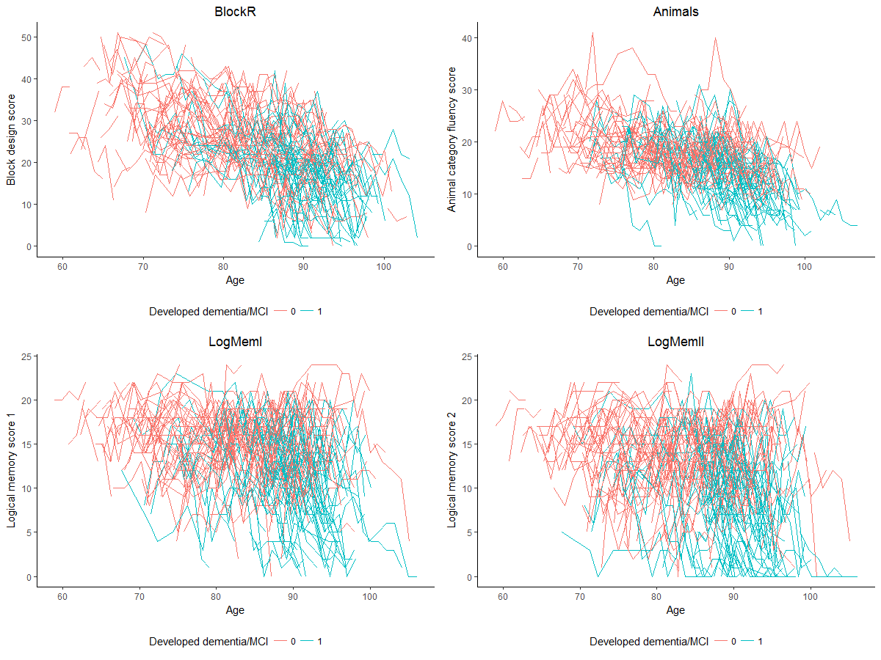

Slide 4
Data Cleaning & Analysis Plan
For each outcome, removed those who did not have 3+ observations
For each outcome, fit linear mixed model to account for correlation induced by repeated measures on subjects
Adjust for baseline age, SES, development of dementia/MCI (Y/N)
Utilize maximum likelihood methods to fit the model for a variety of change-points, adjusting for age of diagnosis of dementia/MCI
Change-point with highest likelihood will be determined to identify at what time prior to diagnosis that rates begin to decline

